Slide 1
API Testing
-Priyanka Nigade

Slide 2
Contents
Introduction to API Testing
Introduction to JSON
Rest-Assured GET,POST,PUT,PATCH,DELETE Request
Postman Basics
Cookies & Header
Query & Path Parameters with Logging
Serial and De-serialisation
Types of Authentication in Rest-Assured

Slide 3
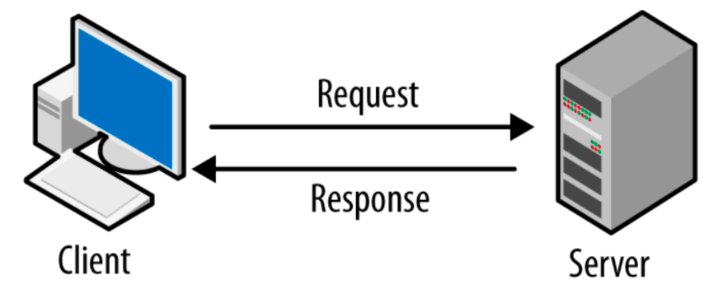
Client-Server Architecture

Slide 4
What is API
An API is a way of communication between two applications.
API Testing a type of software testing that focuses on the testing of individual API methods and the interactions between different APIs
API testing is the only way to provide truly secure, reliable and scalable connections between platforms
Interface can be thought of as a contract of service between two applications.
This contract defines how the two communicate with each other using requests and responses.
Their API documentation contains information on how developers are to structure those requests and responses.

Slide 5
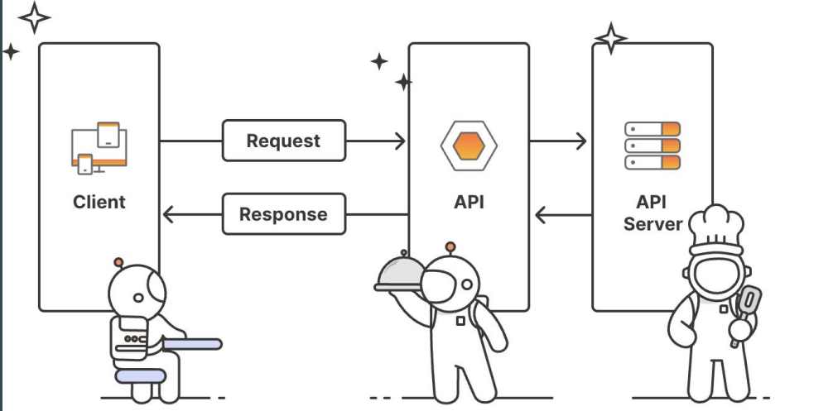
How API Works

Slide 6
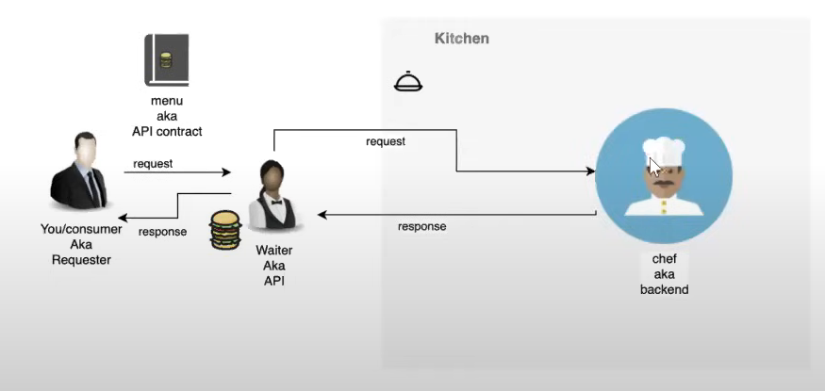
API-Restaurant Analogy

Slide 7
API Client
The API client is responsible for starting the conversation by sending the request to the API server.
The request can be triggered in many ways from any client.

Slide 8
API Request
Endpoint - An API endpoint is a dedicated URL that provides access to a specific resource.
Method - The request's method indicates the type of operation the client would like to perform on a given resource. REST APIs are accessible through standard HTTP methods, which perform common actions like retrieving, creating, updating, and deleting data.
Parameters - Parameters are the variables that are passed to an API endpoint to provide specific instructions for the API to process. These parameters can be included in the API request as part of the URL, in the query string, or in the request body.
Request headers - Request headers are key-value pairs that provide extra details about the request, such as its content type or authentication credentials.
Request body - The body is the main part of the request, and it includes the actual data that is required to create, update, or delete a resource.

Slide 9
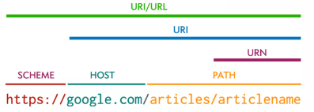
API Terminology
URI: Uniform Resource Identifier
URL: Uniform Resource Locator
URN: Uniform Resource Name

Slide 10
API Server
The API client sends the request to the API server, which is responsible for handling authentication, validating input data, and retrieving or manipulating data.

Slide 11
API Response
Status code –
https://developer.mozilla.org/en-US/docs/Web/HTTP/Status
HTTP status codes are three-digit codes that indicate the outcome of an API request. Some of the most common status codes include 200 OK, which indicates that the server successfully returned the requested data, 201 Created, which indicates the server successfully created a new resource, and 404 Not Found, which indicates that the server could not find the requested resource.
1XX
2XX
3XX
4XX
5XX

Slide 12
API Response
Response headers:
HTTP response headers are very similar to request headers, except they are used to provide additional information about the server's response.
Response body:
The response body includes the actual data or content the client asked for—or an error message if something went wrong.

Slide 13
What is API Testing?
API Testing is testing APIs and its integration with web services.
In an API Testing our main focus will be on a Business logic layer of the software architecture.
API testing strategies are similar to other software testing methodologies.
The main focus is on validating server responses.
API testing includes:
Functional
Non Functional
Performance Testing & Security Testing

Slide 14
Unit testing vs. API testing
Unit Testing | API Testing
Perform by Developers | Perform by Testers
Separate functionality is tested | End to End functionality is tested
Developer can access source code | Tester can not access source code
UI testing is also involve | Only API functions are tested
Only basic functions are tested | All functional issues are tested
Limited in scope | Broader in scope
Usually ran before check-in | Ran after build is created

Slide 15
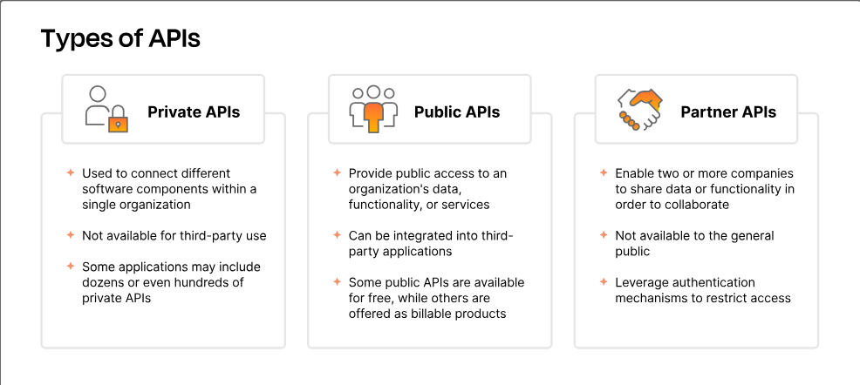

Slide 16
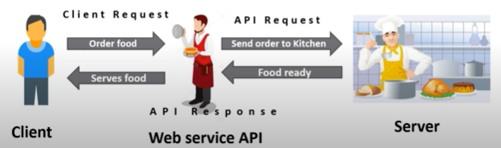
What is web services?
Web service available over the web.
Enable communication between applications over the web.
Provide standard protocol for communication, using web services two different applications can talk to each other & exchange data/Information.

Slide 17
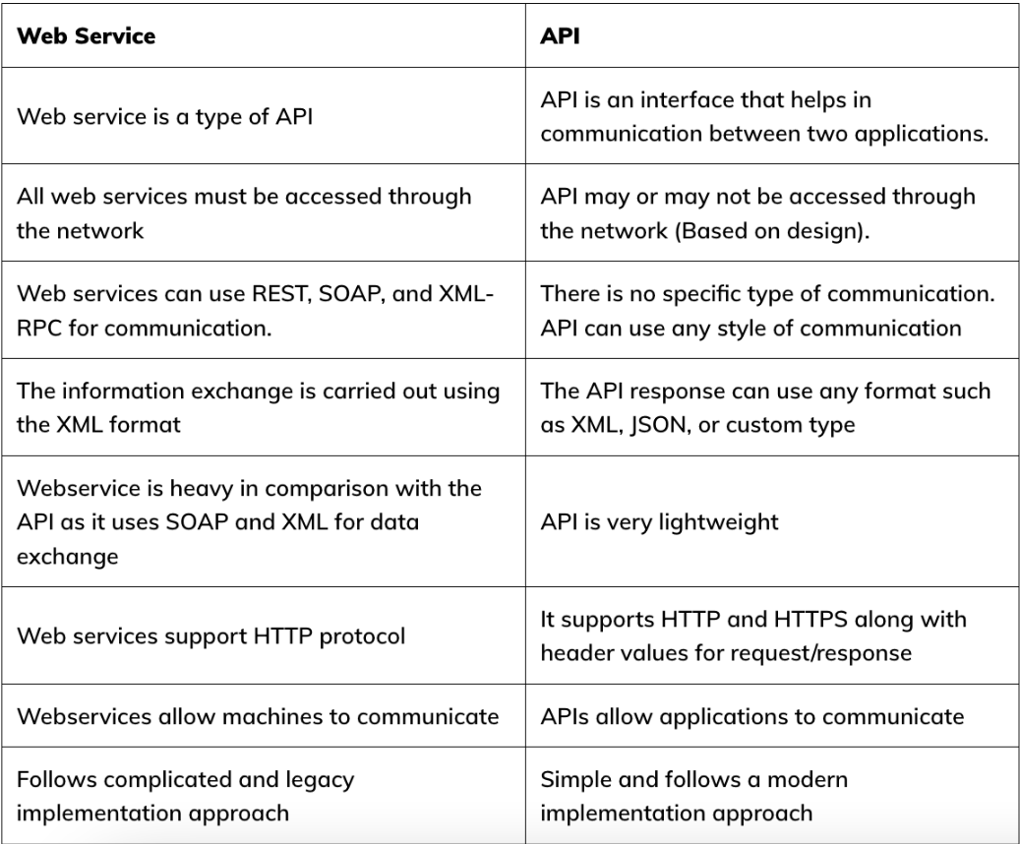

Slide 18
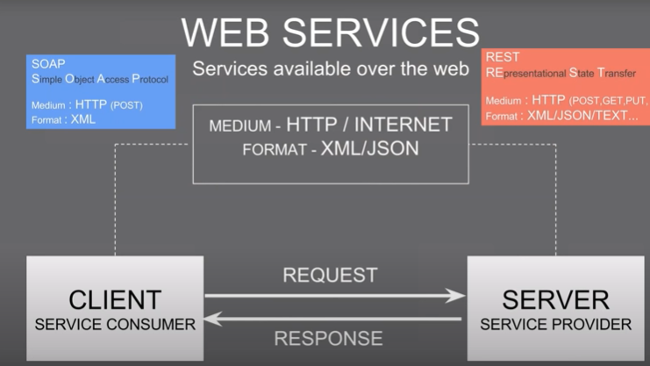

Types of web-services

Slide 19
REST Full web-service
REpresentational State Transfer
A service represents a resource that can be accessed from the web
Commonly make the use of different HTTP request methods to implement CRUD functions
POST- Create new resource
GET- Retrieve resource
PUT- Update resource
DELETE- Delete resource

Slide 20
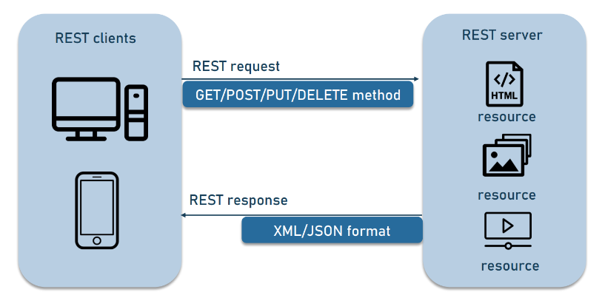
What is REST
REpresentational State Transfer, is an architectural style for providing standards between computer systems on the web, making it easier for systems to communicate with each other.

Slide 21
REST API Examples
Payment Gateway
Google Map
Facebook
Twitter
Linked-In
GITHUB

Slide 22
REST API Key Elements
A Client or software that runs on a user’s computer or smartphone and initiates communication
A Server that offers an API as a means of access to its data or features
A Resource, which is any piece of content that the server can provide to the client (for example, a video or a text file).

Slide 23
Rest API Request Structure
HTTP Method
Endpoint
Headers
Body

Slide 24
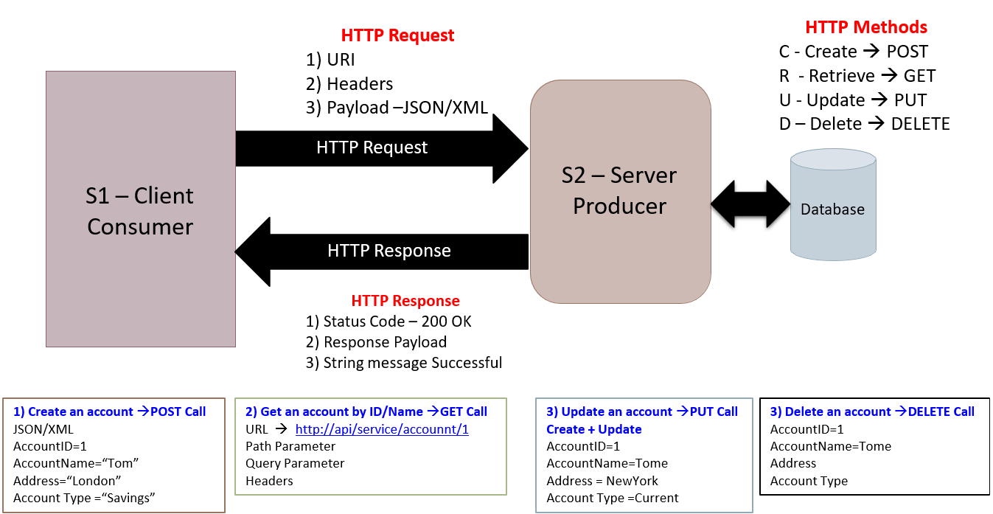
REST API Work-Flow

Slide 25
REST HTTP Methods
GET
POST
PUT
DELETE

Slide 26
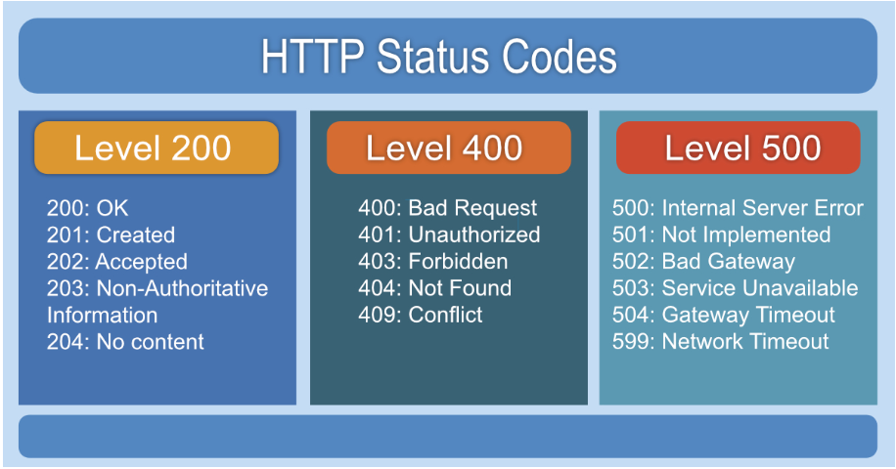
HTTP Status Code
https://developer.mozilla.org/en-US/docs/Web/HTTP/Status

Slide 27
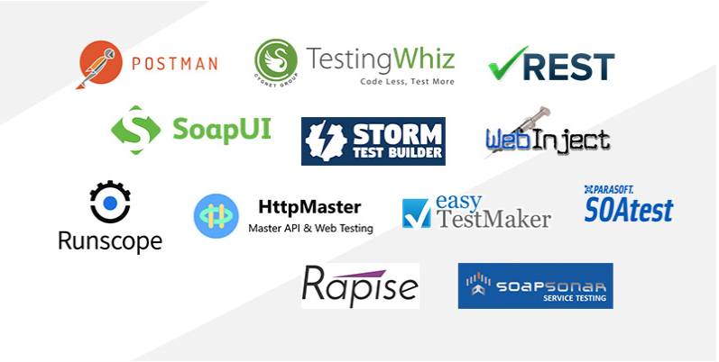
Tools Available

Slide 28
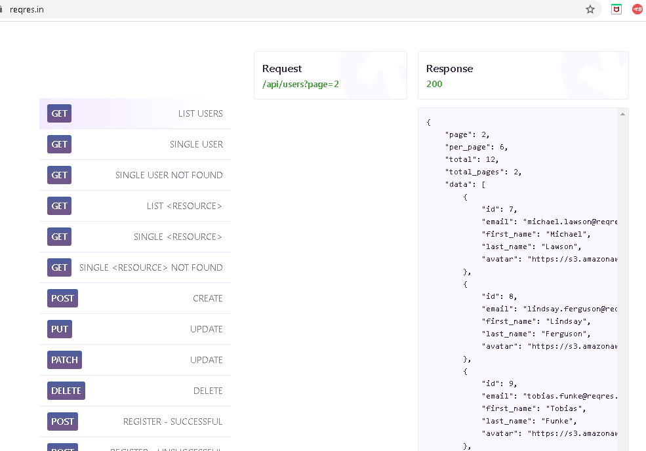
Demo On Browser

Slide 29

Postman
Postman is a collaboration platform for API development.
You can use Postman to design, build, and test APIs in conjunction with your teammates, and to support developer adoption.
Using Postman tool, we can send HTTP/s requests to a service, as well as get their responses.
By doing this we can make sure that the service is up and running.

Slide 30
Postman features
Postman has become a tool of choice for million users.
Open Source
Easy
APIs Support
Extensible
Integration
Community & Support

Slide 31
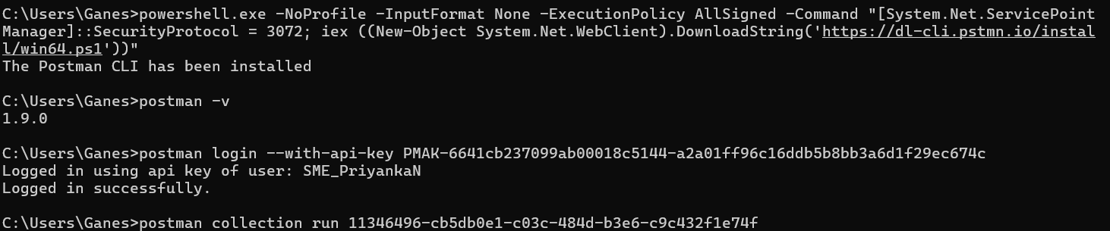
POSTMAN CLI

Slide 32
How To Create Own API
Step 1:Install node.js
https://nodejs.org/en/
Step 2:install json-server
npm install –g json-server
Step 3: Create json file
Step 4: run cmd
json-server jsonfile

Slide 33
JSON

Slide 34
What is JSON
Stands for JavaScript Object Notation
Is lightweight protocol for exchanging data between the client and server.

Slide 35
Why JSON
JSON is recognized natively by JavaScript
Simple format
The easiness of reading
The easiness of using
Lighter than XML

Slide 36










JSON Format
{
"id": 1,
"name": "john",
"location": "india",
"phone": "12345",
"courses“:
[ "java", "selenium“ ]
}

Slide 37
JSON Syntax
Data should be in name/value pair
Data should be separated by comma
Curly brackets should hold object
Square brackets should hold array

Slide 38






JSON Data Types
Number
String
Boolean
Null
Object
Array

Slide 39
Number
Numbers in JSON must be an integer pf a floating point number
{ “age”:30 }
String
String in Json must be written in double quotes
{ “name”: “ Jhon” }
Boolean
Values in JSON can be Boolean (true/false)
{ “status” : true }

Slide 40




JSON Object
Values in JSON can be Object
{
“employee” :
{
“name” : “Jhon” ,
“ age” : 30,
“ city” : “New York”
}
}

Slide 41

JSON Array
In JSON, array values must be of type string, number, object, array, boolean or null.
{
“employee” : [“John”, ”Sam”, ”Tom”]
}
{
“age” : [20,30,40]
}

Slide 42
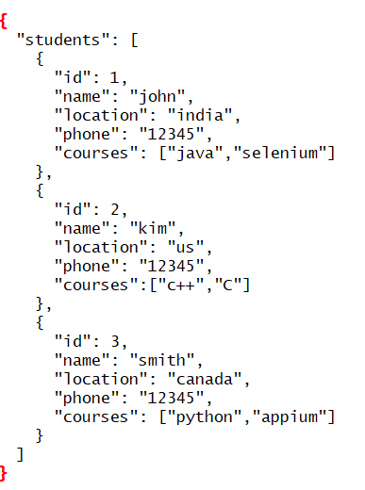
0
1
2

Slide 43
REST-Assured

Slide 44
REST-Assured
Rest assured is java library for testing Restful Web services.
It can be used to test XML & JSON based web services.
It supports GET, POST, PUT, PATCH, DELETE requests and can be used to validate and verify the response of these requests.
https://rest-assured.io/

Slide 45
REST-Assured Setup
Pre-requisite
Java 9+ & Eclipse
TestNG
Maven

Slide 46
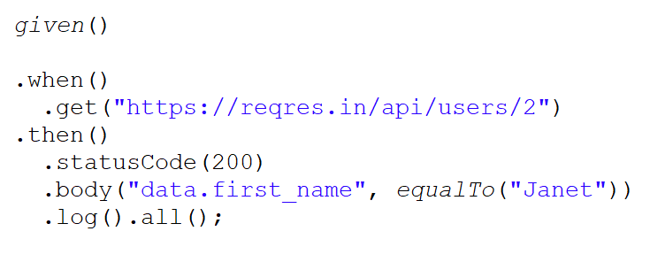
GET Request

Slide 47
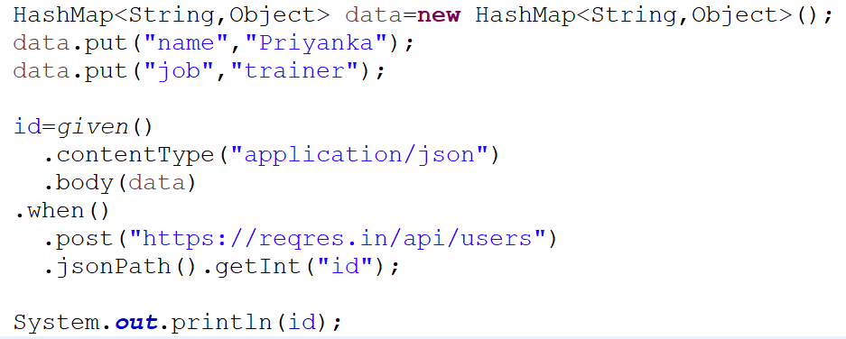
POST Request
POST using HashMap
POST using POJO class

Slide 48
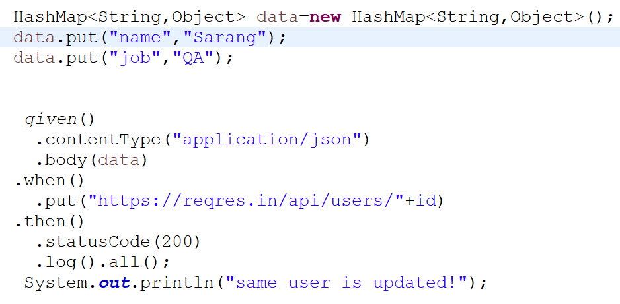
PUT / PATCH Request

Slide 49
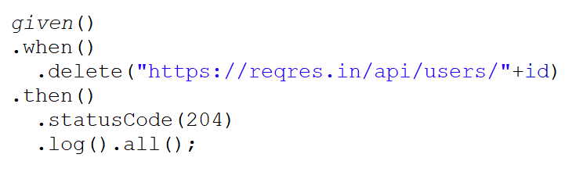
DELETE Request

Slide 50
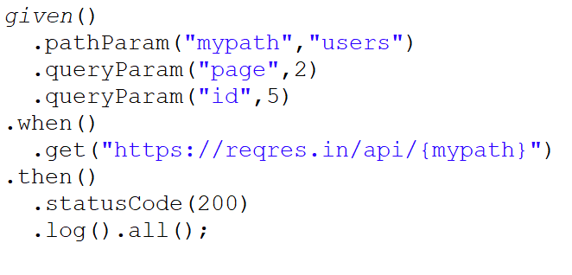
Query & Path Parameters

Slide 51
Cookies Validation
Cookies are small file of information that web servers generates and sends to a web browser.
Cookies help inform websites about the user and enabling the website to personalize the user experience.

Slide 52
Cookies Validation
Cookies are small file of information that web servers generates and sends to a web browser.
Cookies help inform websites about the user and enabling the website to personalize the user experience.

Slide 53
Header Validation
A Response header is an HTTP header that can be used in an HTTP response.
HTTP Headers used to pass additional information between the client and server.

Slide 54
Test Logging
To get all the request and response of REST-Assured use
log().all()

Slide 55
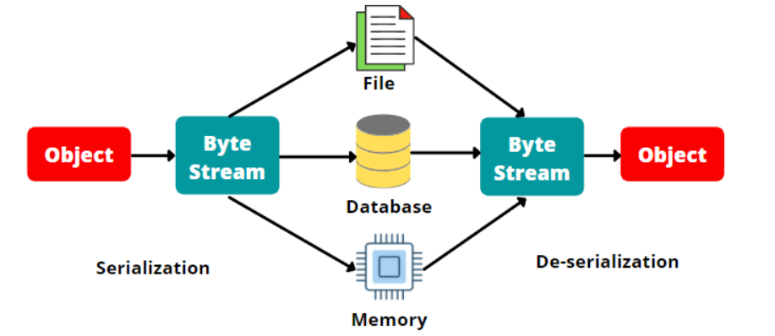
Serialization & Deserialization

Slide 56
Serialization & Deserialization
Serialization is a conversion of the state of a Java object to a byte stream.
ObjectMapper objMap=new ObjectMapper();
String jsondata=objMap.writerWithDefaultPrettyPrinter().writeValueAsString(obj);
Deserialization is the reverse of it i.e. conversion of a byte stream to corresponding Java object.
ObjectMapper obj=new ObjectMapper();
Pojo pojo= obj.readValue(jsondata,Pojoclass.class);
import com.fasterxml.jackson.databind.ObjectMapper;

Slide 57
Authentication Types
Basic Authentication
Digest Authentication
Bearer token Authentication
OAuth 1.0,2.0 Authentication

